Slide 1
IEEE 802.11
Wireless LAN
Tanmay Kumar Pradhan
V V Raja Rao
V Sreenivasulu

Slide 2
Wireless LANs: Characteristics
Types
  Infrastructure based
  Ad-hoc
Advantages
  Flexible deployment
  Minimal wiring difficulties
  More robust against disasters (earthquake etc)
  Historic buildings, conferences, trade shows,…
Disadvantages
  Low bandwidth compared to wired networks (1-10 Mbit/s)
  Proprietary solutions
  Need to follow wireless spectrum regulations

Slide 3
Components/Architecture
Station (STA) - Mobile node
Access Point (AP) - Stations are connected to access points.
Basic Service Set (BSS) - Stations and the AP with in the same radio coverage form a BSS.
Extended Service Set (ESS) - Several BSSs connected through APs form an ESS.

Slide 4

infrastructure
network
AP: Access Point
AP
AP
wired network
AP
ad-hoc network
Source: Schiller

Slide 5
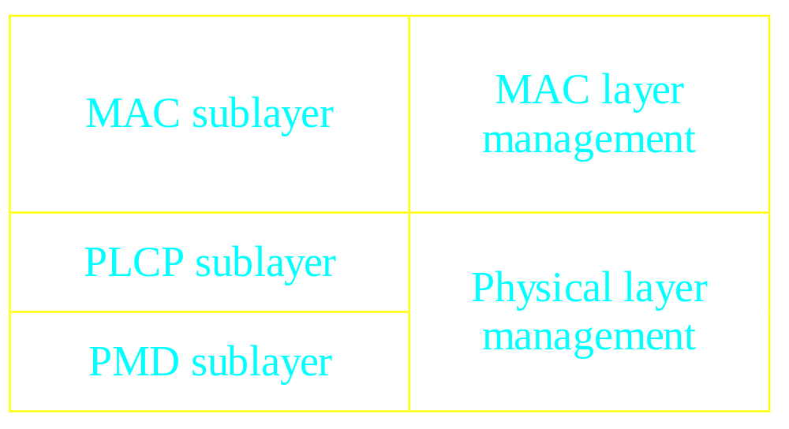
Protocol Architecture

Slide 6
Wireless LAN: Motivation
Can we apply media access methods from fixed networks?
Example CSMA/CD
  Carrier Sense Multiple Access with Collision Detection
  send as soon as the medium is free, listen into the medium if a collision occurs (original method in IEEE 802.3)

Slide 7
Medium access problems in wireless networks
  signal strength decreases proportional to the square of the distance
  sender would apply CS and CD, but the collisions happen at the receiver
  sender may not “hear” the collision, i.e., CD does not work
  CS might not work, e.g. if a terminal is “hidden”

Slide 8
Difference Between Wired and Wireless
Ethernet LAN
Wireless LAN
B
A
B
C
A
C
If both A and C sense the channel to be idle at the same time, they send at the same time.
Collision can be detected at sender in Ethernet.
Half-duplex radios in wireless cannot detect collision at sender.

Slide 9
Hidden Terminal Problem
A
B
C
Hidden terminals
  A and C cannot hear each other.
  A sends to B, C cannot receive A.
  C wants to send to B, C senses a “free” medium (CS fails)
  Collision occurs at B.
  A cannot receive the collision (CD fails).
  A is “hidden” for C.
Solution?
  Hidden terminal is peculiar to wireless (not found in wired)
  Need to sense carrier at receiver, not sender!
  “virtual carrier sensing”: Sender “asks” receiver whether it can hear something. If so, behave as if channel busy.

Slide 10
Medium access control layer
Asynchronous data service (DCF) - CSMA/CA - RTS/CTS
Time bounded service (PCF) - Polling
Inter-frame spacing (IFS) - DIFS - PIFS - SIFS

Slide 11
CSMA/CA
DIFS
DIFS
DIFS
DIFS
station1
station2
station3
station4
station5
t
busy
backoff
Residual backoff

Slide 12
RTS/CTS
RTS
A
B
C
CTS
CTS
802.11 avoids the problem of hidden terminals
  A and C want to send to B
  A sends RTS to B
  B sends CTS to A
  C “overhears” CTS from B
  C waits for duration of A’s transmission

Slide 13
RTS/CTS
DIFS
RTS
SIFS
SIFS
Data
SIFS
sender
CTS
ACK
receiver
NAV (RTS)
bo
Data
Other stations
DIFS
NAV (CTS)
t

Slide 14
Fragmentation
Wireless LANs have high bit error rates.
The probability of erroneous frame is much higher for wireless links
802.11 uses fragmentation to reduce the frame error rate.

Slide 15
Fragmentation
DIFS
RTS
SIFS
SIFS
frag1
SIFS
SIFS
frag2
SIFS
sender
CTS
ACK
ACK
receiver
NAV (RTS)
Other stations
NAV (CTS)
NAV(frag1)
NAV(ACK)
t

Slide 16
PCF with Polling
To provide time bounded service.
Requires an access point.
Access point polls each station during contention free period.
Becomes an overhead during light load

Slide 17
PCF with polling
PIFS
D1
SIFS
SIFS
D2
SIFS
SIFS
AP
U1
U2
station2
NAV (RTS)
station3
t

Slide 18
MAC management
Synchronization - finding and staying with a WLAN - synchronization functions
Power Management - sleeping without missing any messages - power management functions
Roaming - functions for joining a network - changing access points - scanning for access points
Management information base

Slide 19
Synchronization
Timing synchronization function (TSF)
Used for power management - beacons sent at well known intervals - all station timers in BSS are synchronized

Slide 20
Synchronization
Beacon interval
Access
point
B
B
B
B
B
busy
busy
busy
busy
medium
t
B
beacon
Value of time stamp

Slide 21
Power Management
Mobile devices are battery powered - power management is important for mobility
802.11 power management protocol - allows transceiver to be off as much as possible - is transparent to existing protocols

Slide 22
Power management approach
Allow idle stations to go to sleep - station’s power save mode stored in AP
APs buffer packets for sleeping stations - AP announces which stations have frames buffered - traffic indication map (TIM) sent with every beacon
Power saving stations wake up periodically

Slide 23
Power management
TIM interval
DTIM interval
Access
point
D
B
T
T
d
busy
busy
busy
busy
medium
station
p
d
t
B
Broadcast/
multicast
Data transmission
to/from the station
p
PS poll
d

Slide 24
Roaming
Mobile stations may move - beyond the coverage area of their AP - but within range of another AP
Re association allows station to continue operation.

Slide 25
Roaming approach
Station decides that link to its current AP is poor.
Station uses scanning function to find another AP
Station sends Re-association Request to new AP
If Re-association Response is successful - then station has roamed to the new AP - else station scans for another AP
If AP accepts Re-association Request - AP indicates Re-association to the distributed system - Distributed system information is updated

Slide 26
Scanning
Scanning is required for many functions - finding and joining a network - finding a new access point during roaming
Passive scanning - find networks simply by listening for beacons
Active scanning - on each channel send a probe and wait for probe response

Slide 27
References
Brian P Crow, Indra Widjaja, J G Kim, Prescott T Sakai. IEEE 802.11 Wireless Local Area Networks. IEEE Communications Magazine
www.breezecom.com
Jochen H. Schiller, Mobile Communications

